Slide 1
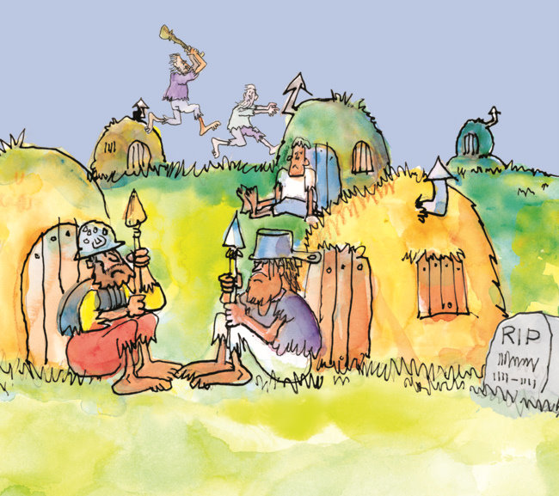
Locke II: The State of Nature and Property
Politics 2A
Dr Carl Knight, Lecturer in Political Theory

Slide 2
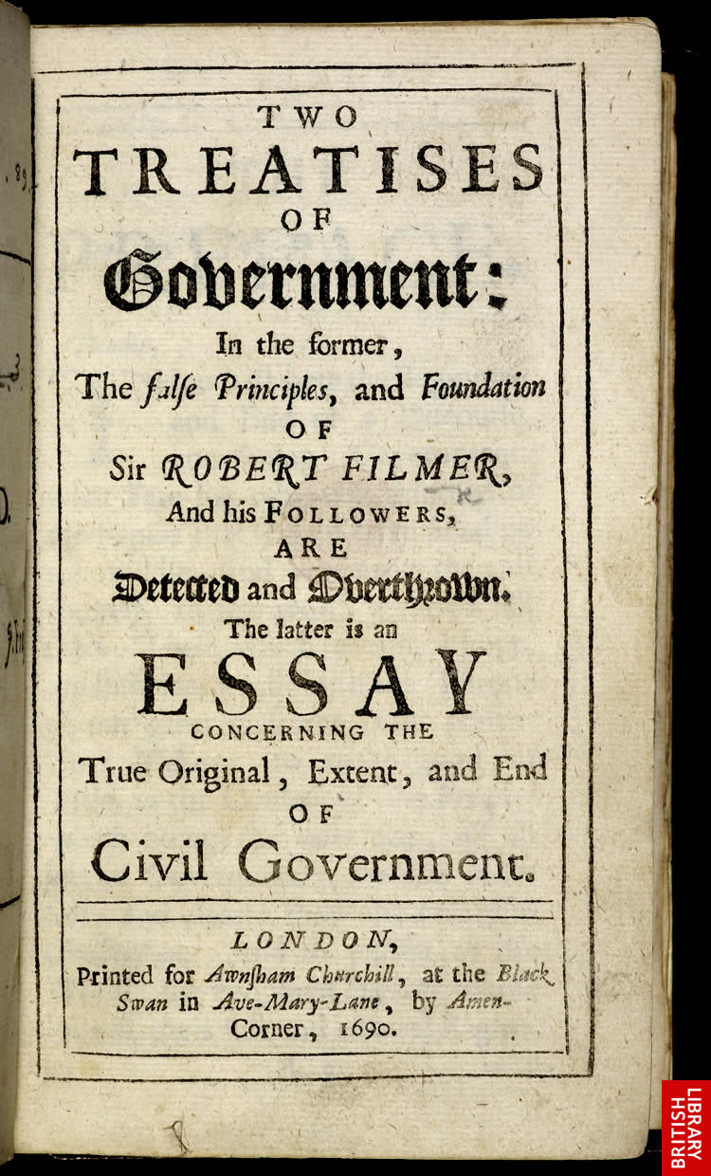
LOCKE’S TWO TREATISES OF GOVERNMENT
The First Treatise is a minute exegesis of scripture to disprove Filmer’s divine right of kings theory.
The Second Treatise contains the main part of Locke’s political theory, including his accounts of the state of nature, property, and civil government.

Slide 3
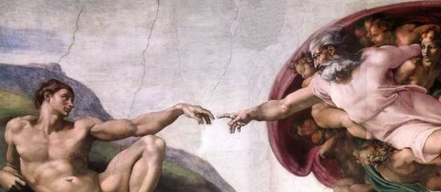
FUNDAMENTAL ASSUMPTION
Main proposition (for Locke, a common-sense starting-point): people and how they are organized are the workmanship of God. They are His servants, His property (§ 6)

Slide 4
EQUALITY
Two inferences from fundamental assumption: we are all free and we are all equal – free of each other and equal to each other (not to God or animals):
‘there being nothing more evident, than that Creatures of the same species and rank promiscuously born to all the advantages of Nature, and the use of the same faculties, should also be equal one amongst another without Subordination or Subjection’.
Contra Filmer, who said that Revelation proves God sets some men above others, men above women, etc
Also contrary to Hobbes - this equality is not equality of strength/wits, but rather moral equality

Slide 5

LAW OF NATURE
For Locke, law of nature is the binding law of God, from which all rights and duties are derived
Reason ‘the Voice of God’ in man (1st Treatise, § 86).
Reason also ‘the rule betwixt man and man’ (§ 172)
Unlike Hobbes’ natural law, Locke’s law has (1) theological basis & (2) extends past self-interest

Slide 6

FREEDOM
‘We are born Free, as we are born rational’ (§ 61)
Absolute freedom is meaningless, it must be defined – ‘Where there is no Law, there is no freedom’ (§ 57)
Liberty is not ‘license’: law of nature sets bounds to natural freedom (§ 4)
Given natural law & reason, why have government?

Slide 7
NATURAL FREEDOM
Prior to government people have ‘Perfect Freedom to order their actions as they think fit, within the bounds of the law of nature, without asking leave, or depending on the will of other men’
People don’t have to refer to others’ wishes in SON
But unlike Hobbes, they’re under restrictions other than mere prudence (‘what you can get away with’)
Moral restrictions even before contract: ‘being all equal and independent, no one ought to harm another in his Life, Health, Liberty, or Possessions’ (§ 7)

Slide 8
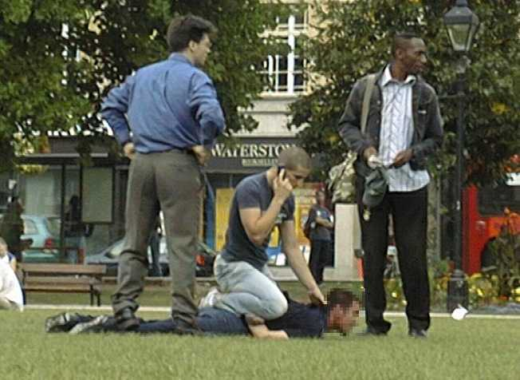
EXECUTIVE POWER
Freedom limited by the law of nature means that everyone has ‘the executive power of the law of nature’ (§ 6-9, 13).
This is necessary as someone has to put law into practice, and in state of nature all are equal. Similar to punishing foreigner – consent to laws not needed.
If anyone offends law of nature, everyone else has right to punish her/him for two ends: (1) restraint, including deterrence (may extend to killing murderer, for instance); (2) reparation to victim.

Slide 9

NATURAL RIGHTS
Executive power is both to ensure justice is done, and to protect oneself. Therefore, right to punish becomes a fundamental, individual natural right, set alongside right to self-preservation (§ 128-30).
Right to self-preservation weaker counterpart right of nature in Hobbes - may not harm preemptively
You are equally obliged to protect others – self-defence is just part of mutual defence.

Slide 10
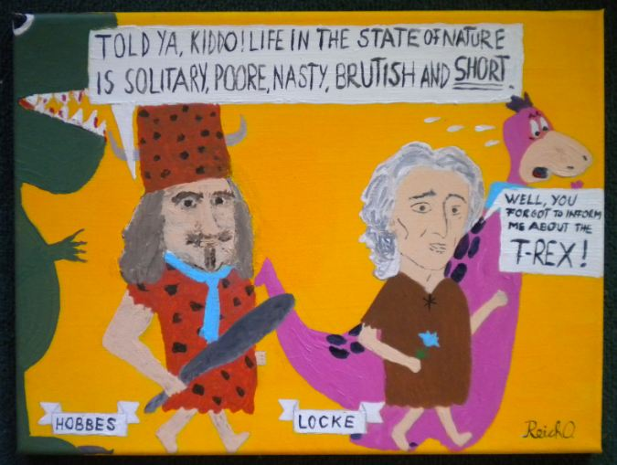
THE STATE OF NATURE
Executive power in private hands=in state of nature
Like Hobbes, believed that the state of nature still exists among primitive tribes without law (II, § 14): ‘In the beginning all the World was America’ (II, § 49)
On Locke’s view, mankind is first social and only later political. People are naturally sociable, and have an interest in others’ well-being.

Slide 11
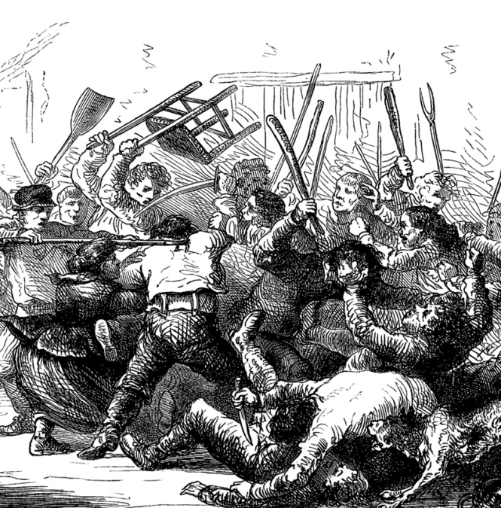

A STATE OF WAR?
Contra Hobbes, SON doesn’t mean state of war:
‘they are as far distant, as a state of peace, good will, mutual assistance, and preservation, and a state of enmity, malice, violence, and mutual destruction are one from another’ (§ 19)
a state of war is not the norm, but only arises where one person rejects reason and tries to kill/dominate
Absolute monarchy can bring about state of war, because monarch substitutes the rule of will and force for the rule of reason through natural law

Slide 12

INCONVENIENCES OF THE S.O.N.
Every person is judge in own case (II, § 13), hence:
1. ‘Unreasonable’: ‘Self-love will make men partial to themselves and their Friends. And on the other side, … Ill Nature, Passion, and Revenge will carry them too far in punishing others’.
2. No publicly settled law, so even if there were impartial judges, no widely accepted law to apply.
3. Often laws, even when recognized, are not acted upon as it is dangerous to punish wrongdoers.
4. When a state of war starts, it can only be ended by political authority.

Slide 13

ACTIVITY
Would the state of nature be ‘a state of peace, good will, mutual assistance, and preservation’?
You may wish to discuss Locke’s arguments about:
Equality, freedom and the law of nature
The natural sociability of humans
Executive power and natural rights
The ‘inconveniences’ of the state of nature

Slide 14

PROPERTY
Locke’s motive for leaving SON due to property
Modern ‘liberal’ conception of the right to property:
1) Right to exclude others from use/benefit of object
2) Right to dispose of something as one pleases
Locke’s conception is broader re: 1), narrower re: 2). Property is more than objects, and use has bounds.
People join in civil society with others ‘for the mutual Preservation of their Lives, Liberties and Estates, which I call by the general Name, Property’ (§ 123)

Slide 15
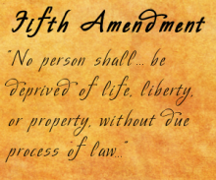
TYPES OF PROPERTY
1. Lives = The continued existence of oneself as a physical being (i.e. self-preservation in narrow sense)
2. Liberties = various rights that a person has in relation to others and to society as a whole
3. Estates = land and goods (closest to what we today mean by the term ‘property’)

Slide 16

PROBLEM OF PROPERTY
How did individuals gain exclusive rights to land & objects given equal start?
‘I shall endeavour to shew, how Men might come to have a property in several parts of that which God gave to Mankind in common, and that without any express Compact of all the Commoners’ (§ 25)

Slide 17
MAIN ARGUMENT FOR PROPERTY
God gave the world to mankind in common to use
He also gave human beings reason, so that they would make the best possible use of the earth
In order to do this, human beings must ‘appropriate’ natural objects, i.e. make them exclusively theirs
Human beings own themselves (self-ownership)
Property appropriated by ‘mixing’ of labour (§ 27): ‘Whatsoever then he removes out of the State that Nature hath provided, and left it in, he hath mixed his Labour with, and joined to it something that is his own, and thereby makes it his Property’

Slide 18
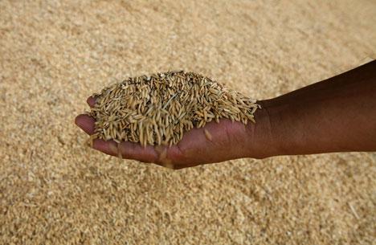
TWO (OR THREE?) PROVISOS
Appropriation only permitted if no real scarcity – permissible ‘at least where there is enough, and as good left in common for others’ (§ 27)
Can appropriate only as much ‘as any one can make use of to any advantage of life before it spoils’ (§ 31)
Macpherson claims a third apparent restriction – can only appropriate property through your own labour

Slide 19

REMOVING THE PROVISOS?
Wastage proviso removed by collective invention of money, which doesn’t spoil; inequality by consent
‘Enough and as good’ proviso redundant due to productivity of property: ‘the provisions serving to the support of humane life, produced by one acre of inclosed and cultivated land, are (to speak much within compasse) ten times more…’ (§ 37)
Labour may be reassigned from original owner by agreement: ‘the Turfs my Servant has cut’ (§ 37)

Slide 20
CRITIQUE
Macpherson claims that Locke set out to defend laissez-faire capitalism (‘possessive individualism’) via removal of the provisos
But Tully points out that Locke does at least defend a duty of charity in the First Treatise
Locke assumes that fruit of waged labour justly falls to employer. But he invested in unwaged labour – slavery! – and drafted constitution of Carolina
Does this show that Locke applied the theory in prejudiced fashion, or that theory itself is wrong?

Slide 21
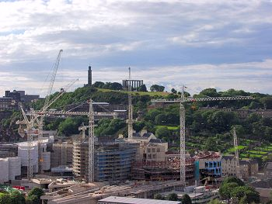
Next Lecture: The Establishment of Civil Government

